Slide 1

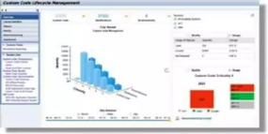
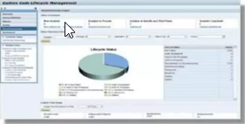
CUSTOM CODE MIGRATION PROCESS
Step 1: Custom Code Evaluation
Transparency with Custom Code Lifecycle Management (CCLM)
Monitor usage of your custom code via Usage and Procedure Logging (UPL)
Use Usage data to prioritize your custom code efforts
Remove Waste with CCLM decommissioning cockpit
Remove unused code before the S/4HANA conversion

Slide 2
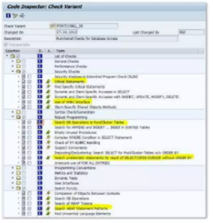
CUSTOM CODE MIGRATION PROCESS
Step 2: Code Inspector Checks for SAP HANA
Code Inspector checks for SAP HANA verify whether your custom code
Uses DB-specific features like native SQL, DB hints or ADBC
Relies on not guaranteed or implicit sorting of database queries
Performs DB Operations on physical pool/cluster database tables
Uses function modules to retrieve technical DB index information
Recommendation
Run code Inspector variant FUNCTIONAL_DB for your custom code
Fix all errors and warnings (findings with priority 1 and 2)

Slide 3
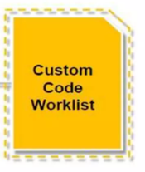
CUSTOM CODE MIGRATION PROCESS
Step 3: SAP S/4HANA Custom Code Analysis Process
03
Custom Code overview
Transaction SYCM
01
Custom Code Analysis
Used/extended/modified/
SAP objects
02
Simplification database
Changed/deleted/SAP objects/
SAP Notes
04
Code Inspector Check
Run Custom code Analyzer towards existing SAP Business Suite System
Download Simplification Database from SAP Service Marketplace
Run SAP Code Inspector and Transaction SYCM to compare the Simplification Database against Custom Code

Slide 4
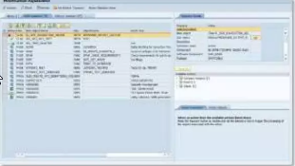
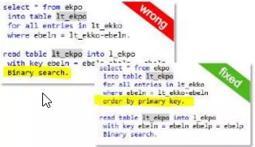
CUSTOM CODE MIGRATION PROCESS
Adjust modifications:
Transactions SPDD and SPAU same process as in previous upgrades
Recommendation:
Reset as many objects as possible to SAP standard
Fix SAP HANA Findings
Use code inspector variant FUNCTIONAL_DB
Same checks as for the migration to SAP Business Suite on HANA
Fix SAP S/4 HANA Findings
Use custom code overview and code inspector checks related to SAP S/4 HANA.
Adapt findings as described in the referenced SAP Notes

Slide 5
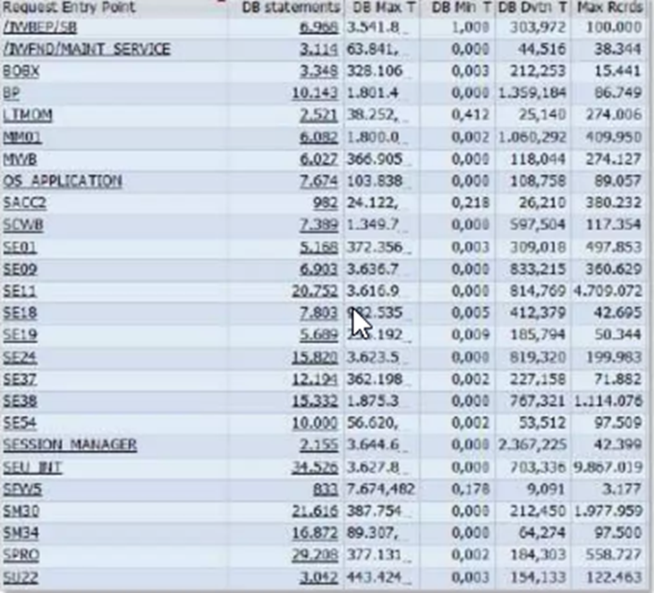
CUSTOM CODE MIGRATION PROCESS
Step 5: Performance Tuning using SQL Monitoring
SQL Monitor allows to get performance data for all SQLs executed in your productive system:
What are the most expensive and most frequently executed SQLs?
Which SQL reads/writes millions of records?
What is the SQL profile of my business process VA01?
SQL Monitor allows to link the monitored SQL to the driving business process
Available for NW release 7.00 and higher
SQL Monitor does not harm your business processes (performance overhead <3%)

